Slide 1

Random Chat
Application
Prajwal Sharma (19BCS1144)
CSE 1-C

Slide 2

CONTENT :
Introduction & History
About This Project
Benefits & Work Area
Structure
Working
Team Work
What we learned

Slide 3
INTRODUCTION & HISTORY
• Instant messaging (IM) technology is a type of online chat allowing real-time text transmission over the Internet or another computer network. Messages are typically transmitted between two or more parties, when each user inputs text and triggers a transmission to the recipient(s), who are all connected on a common network. It differs from email in that conversations over instant messaging happen in real-time (hence "instant"). Most modern IM applications (sometimes called "social messengers", "messaging apps" or "chat apps") use push technology and also add other features such as emojis (or graphical smileys), file transfer, chatbots, Voice over IP, or video chat capabilities.
• Instant messaging systems tend to facilitate connections between specified known users (often using a contact list also known as a "buddy list" or "friend list"), and can be standalone applications or integrated into e.g. a wider social media platform, or a website where it can for instance be used for conversational commerce. IM can also consist of conversations in "chat rooms". Depending on the IM protocol, the technical architecture can be peer-to-peer (direct point-to-point transmission) or client–server (an IM service center retransmits messages from the sender to the communication device). It is usually distinguished from text messaging which is typically simpler and normally uses cellular phone networks.

Slide 4
INTRODUCTION & HISTORY
• Instant messaging was pioneered in the early Internet era; the IRC protocol was the earliest to achieve wide adoption. Later in the 1990s, ICQ was among the first closed and commercialized instant messengers, and several rival services appeared afterwards as it became a popular use of the Internet. Beginning with its first introduction in 2005, BlackBerry Messenger, which initially had been available only on BlackBerry smartphones, soon became one of the most popular mobile instant messaging apps worldwide. BBM was for instance the most used mobile messaging app in the United Kingdom and Indonesia. Instant messaging remains very popular today; IM apps are the most widely used smartphone apps: in 2018 there were over 1.3 billion monthly users of WhatsApp and Facebook Messenger, and 980 million monthly active users of WeChat.
• Instant messaging is a set of communication technologies used for text-based communication between two (private messaging) or more (chatroom) participants over the Internet or other types of networks (see also LAN messenger). IM–chat happens in real-time. Of importance is that online chat and instant messaging differ from other technologies such as email due to the perceived quasi-synchrony of the communications by the users. Some systems permit messages to be sent to users not then 'logged on' (offline messages), thus removing some differences between IM and email (often done by sending the message to the associated email account).

Slide 5
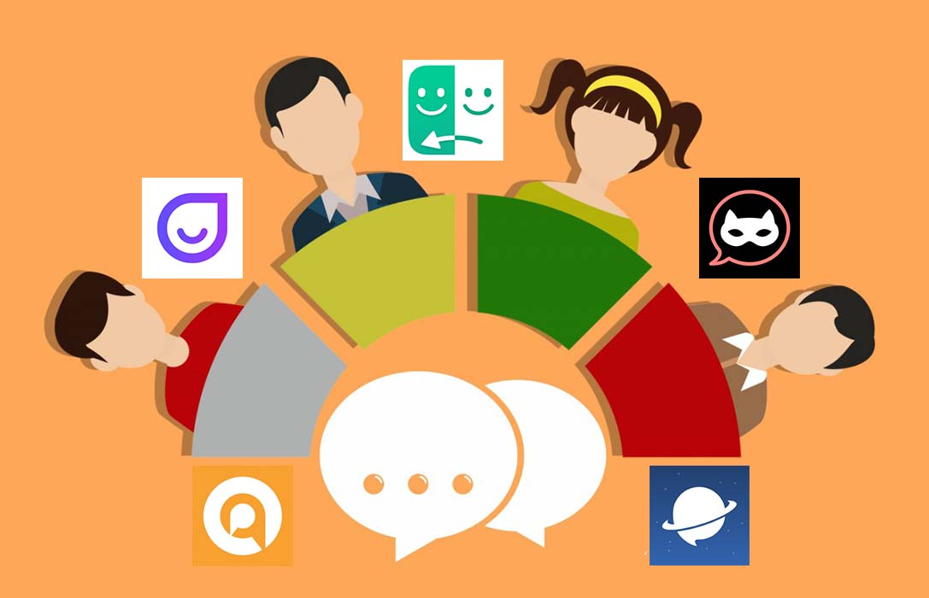
ABOUT THIS PROJECT
DEFINITION : A chat room is a Web site, part of a Web site, or part of an online service such as America Online, that provides a venue for communities of users with a common interest to communicate in real time.
• Random Chat Application is a type of web application in which user can talk to random people with anonymous name.

Slide 6
BENEFITS & WORK AREA
=> You are anonymous when you are chatting with random people.
WORK AREAS :
Chance to meet new people with different views.
The opportunity to get perspectives from around the world.
Easy to find people based on your age, gender identity, sexual orientation, interests, and goals (whether you're looking for social support or dating).

Slide 7
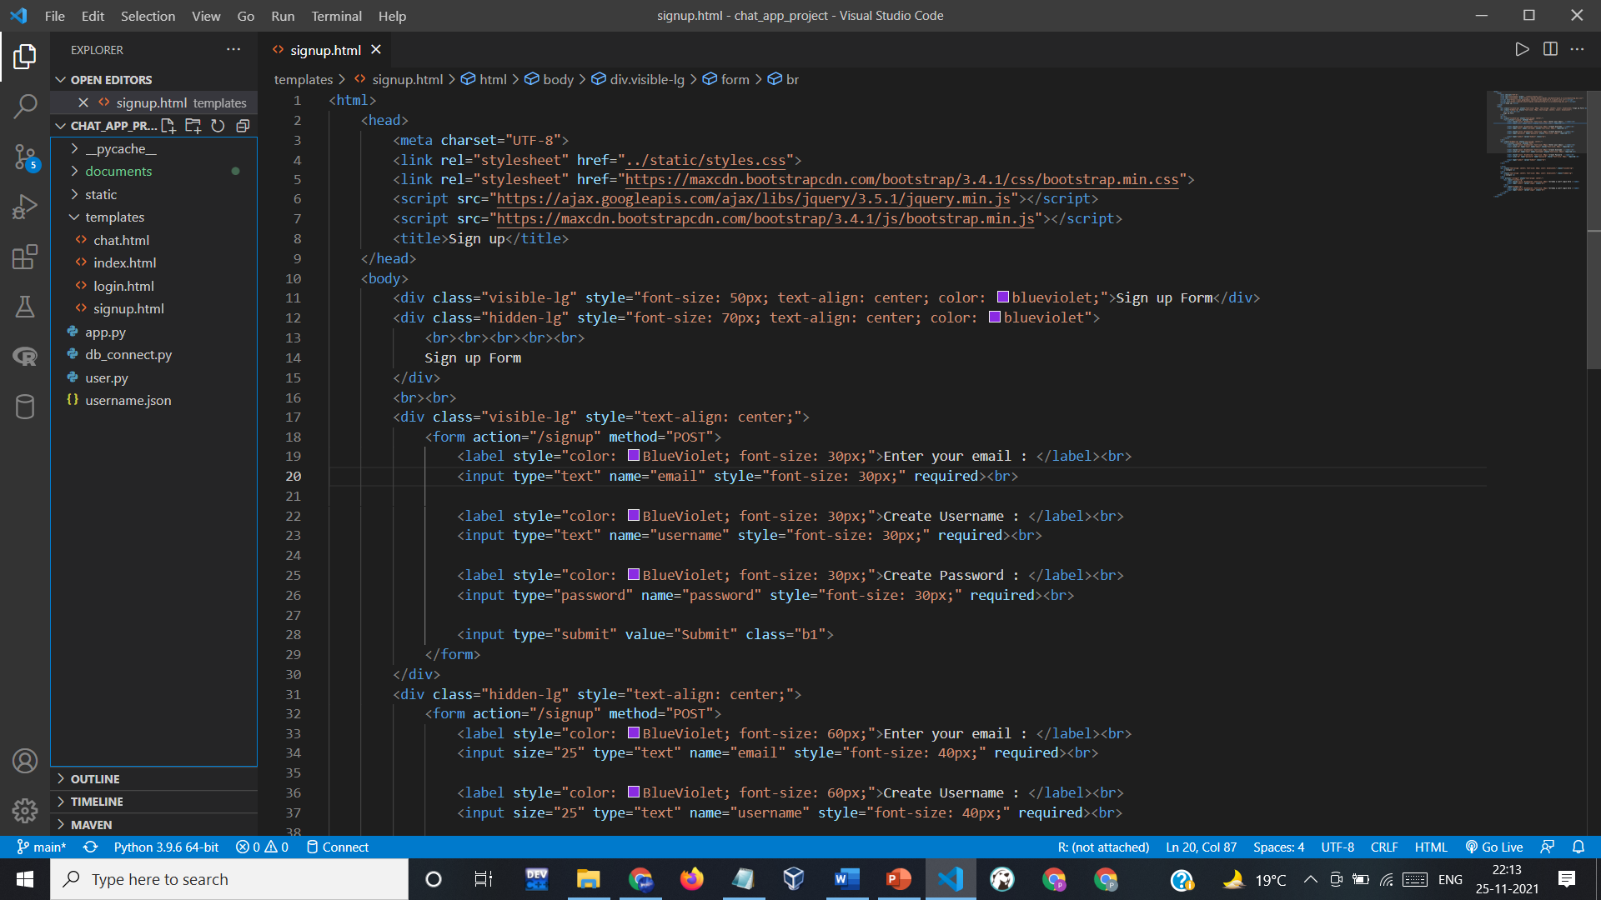
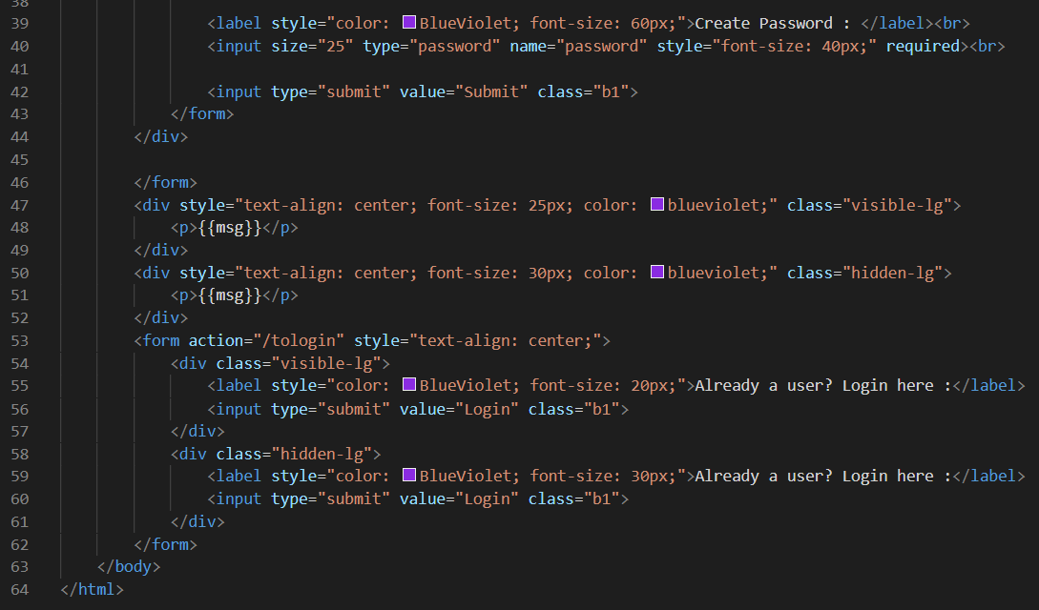
STRUCTURE =>
1. SIGNUP PAGE :

Slide 8
STRUCTURE =>
1. SIGNUP PAGE :

Slide 9
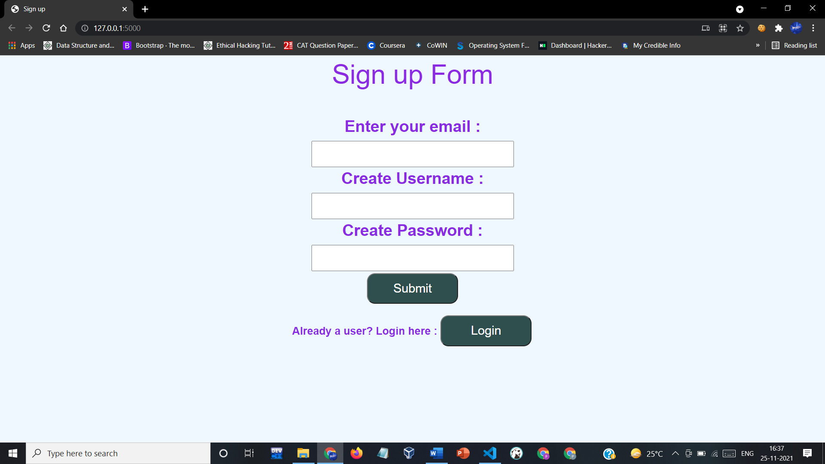
STRUCTURE
1. SIGNUP PAGE :

Slide 10

2. LOGIN PAGE :

Slide 11
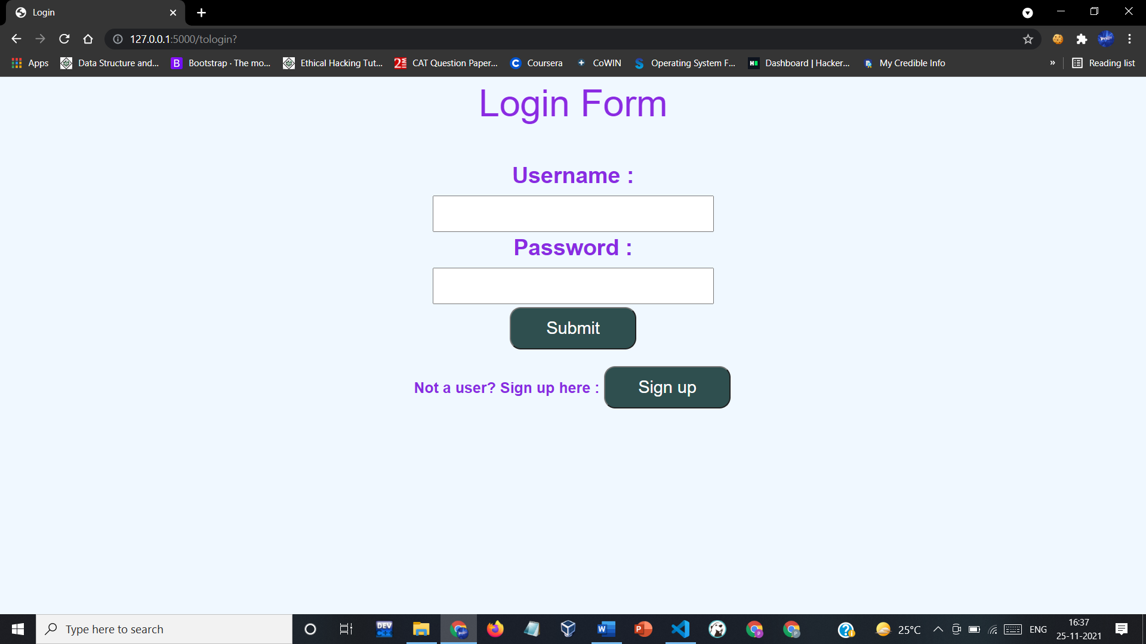
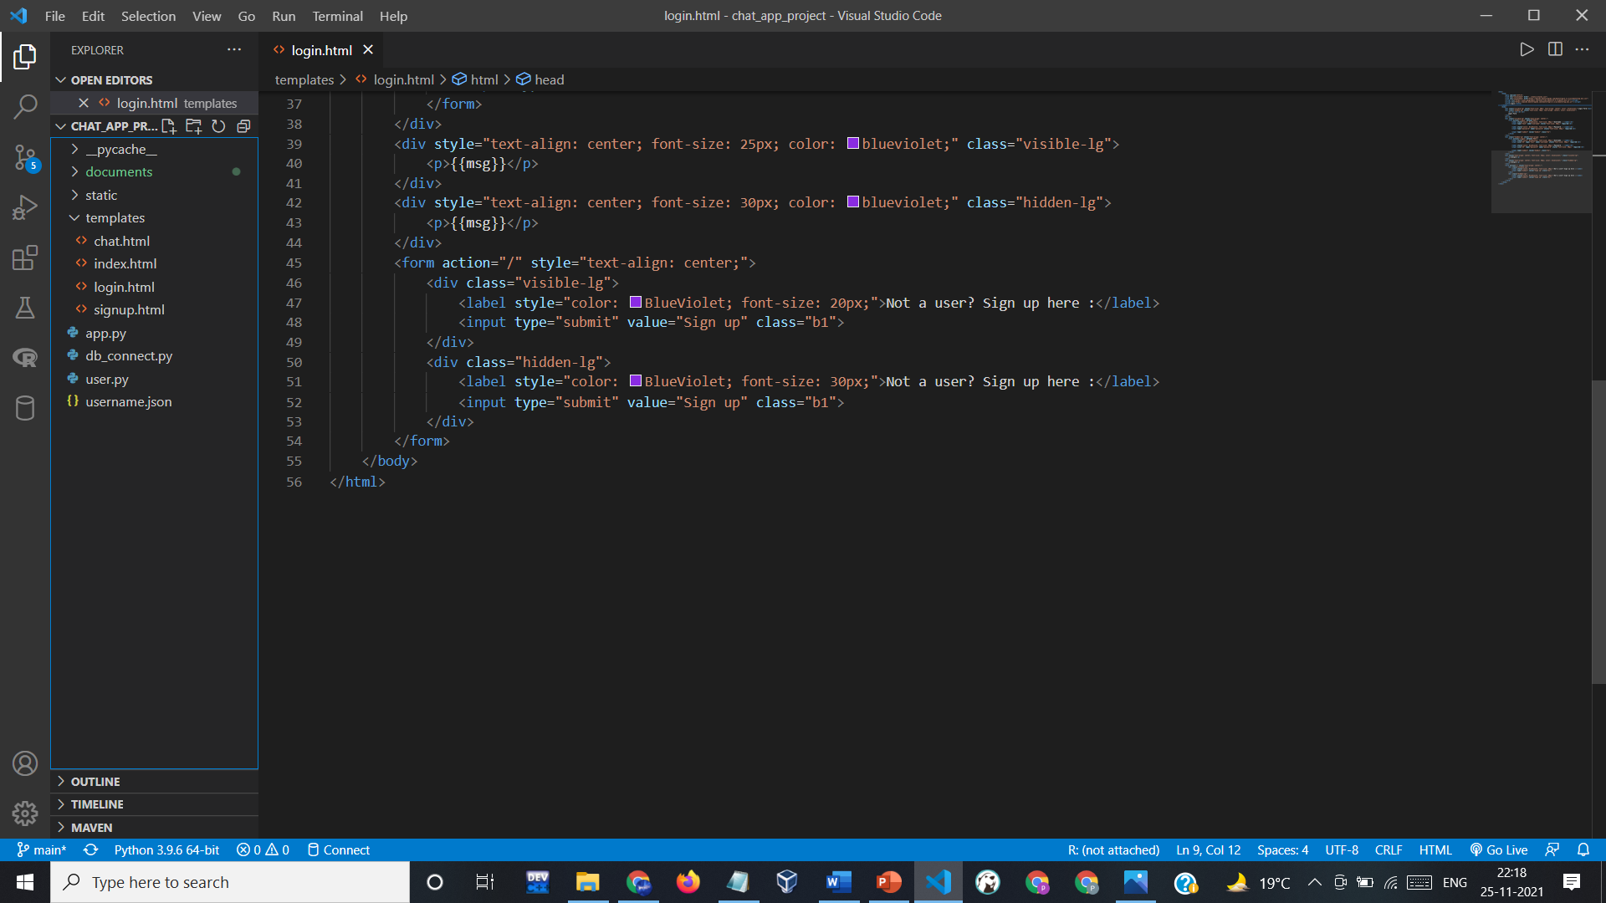
2. LOGIN PAGE :

Slide 12
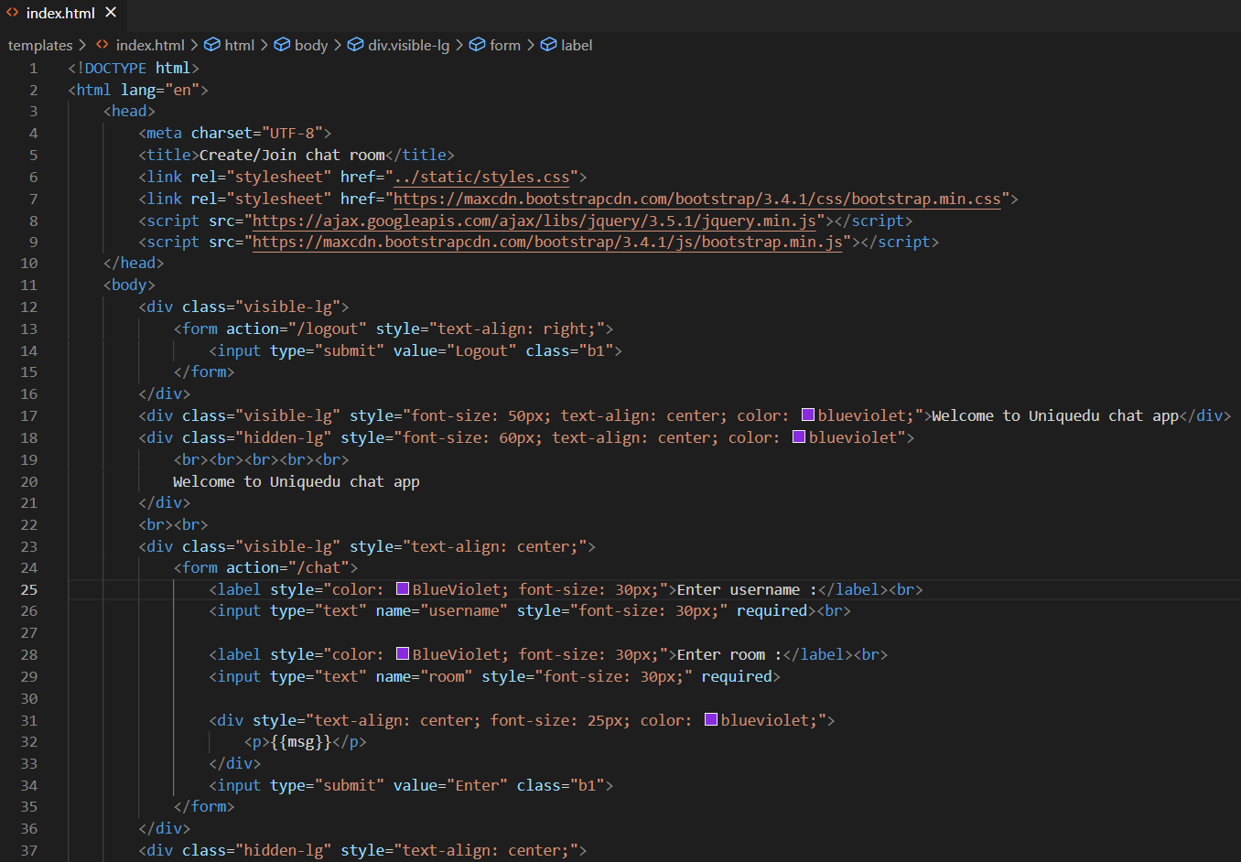
3. ROOM JOINING/CREATING PAGE :

Slide 13
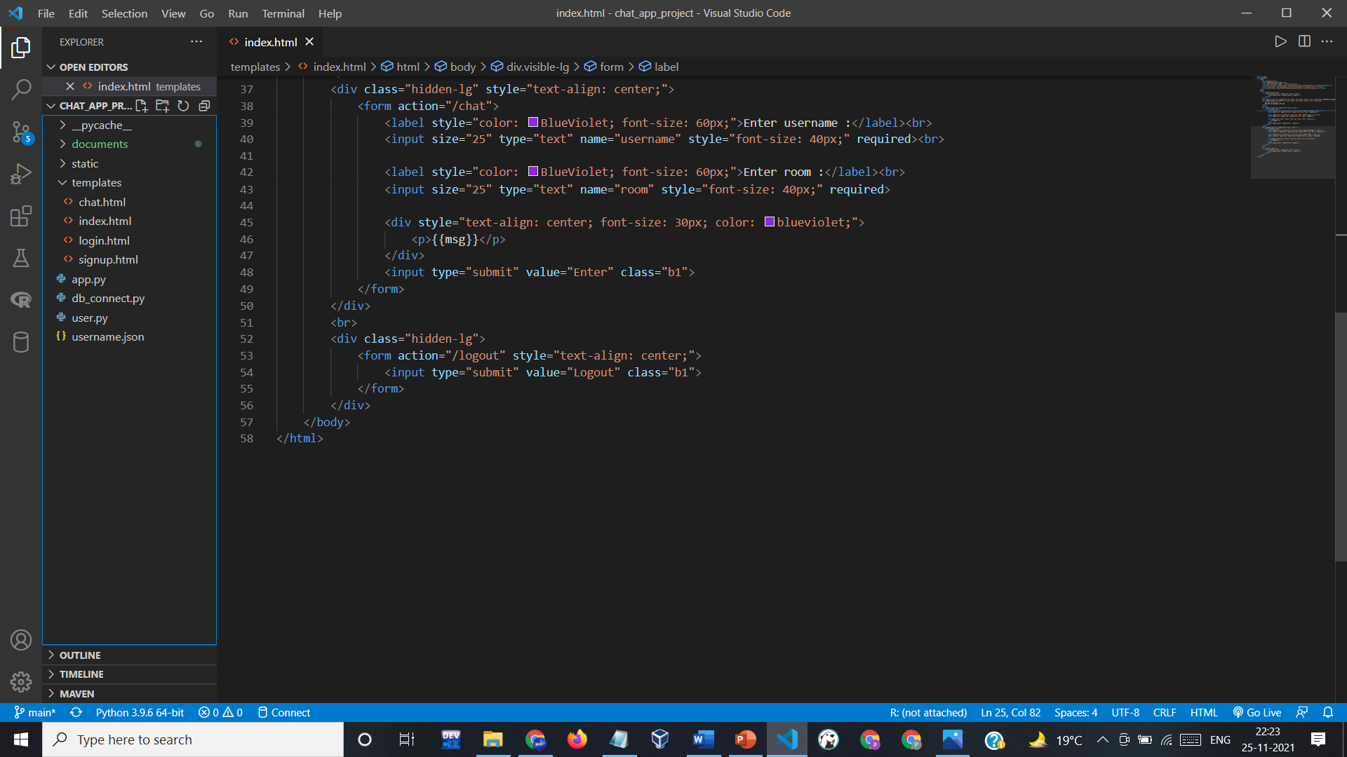
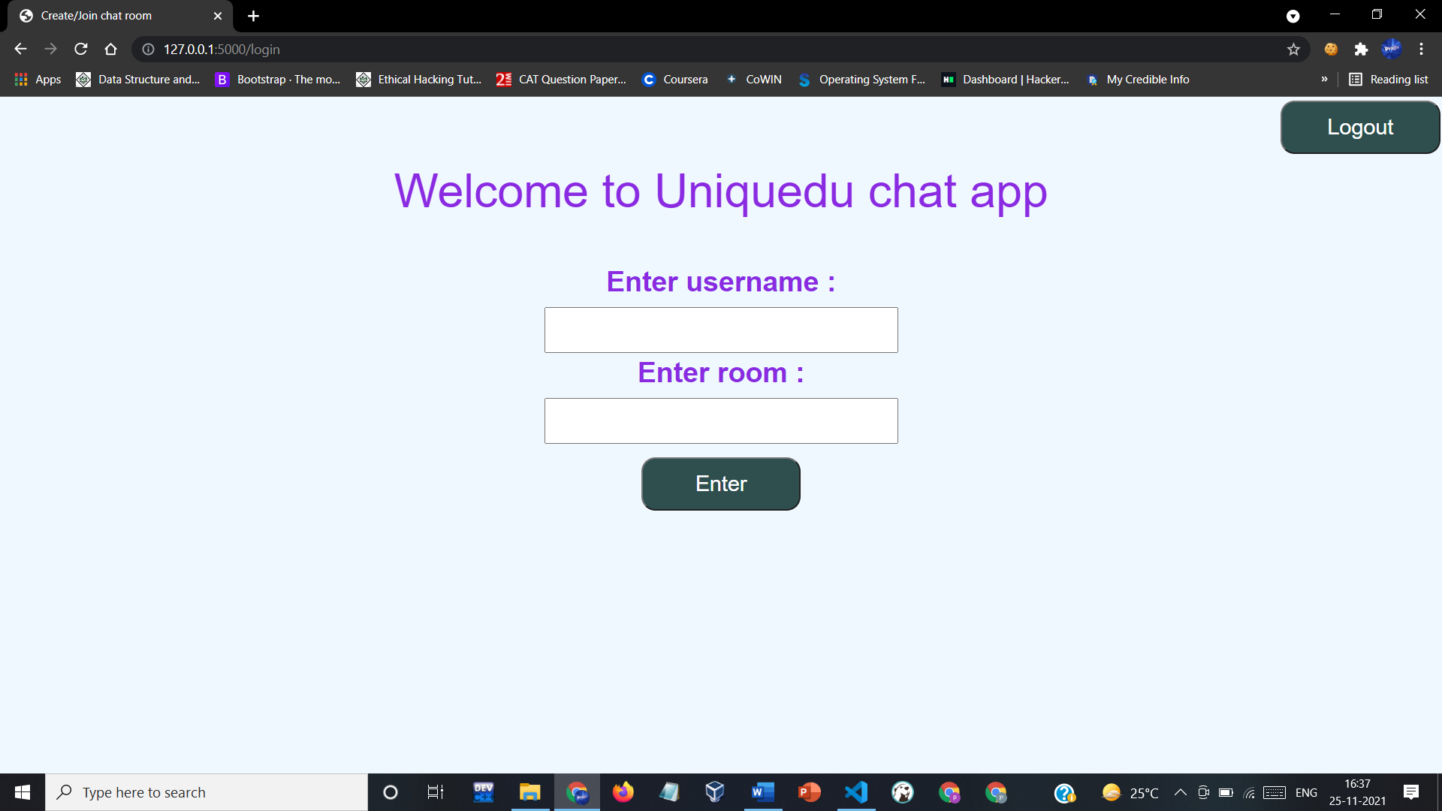
3. ROOM JOINING/CREATING PAGE :

Slide 14

4. MESSAGING PAGE :

Slide 15
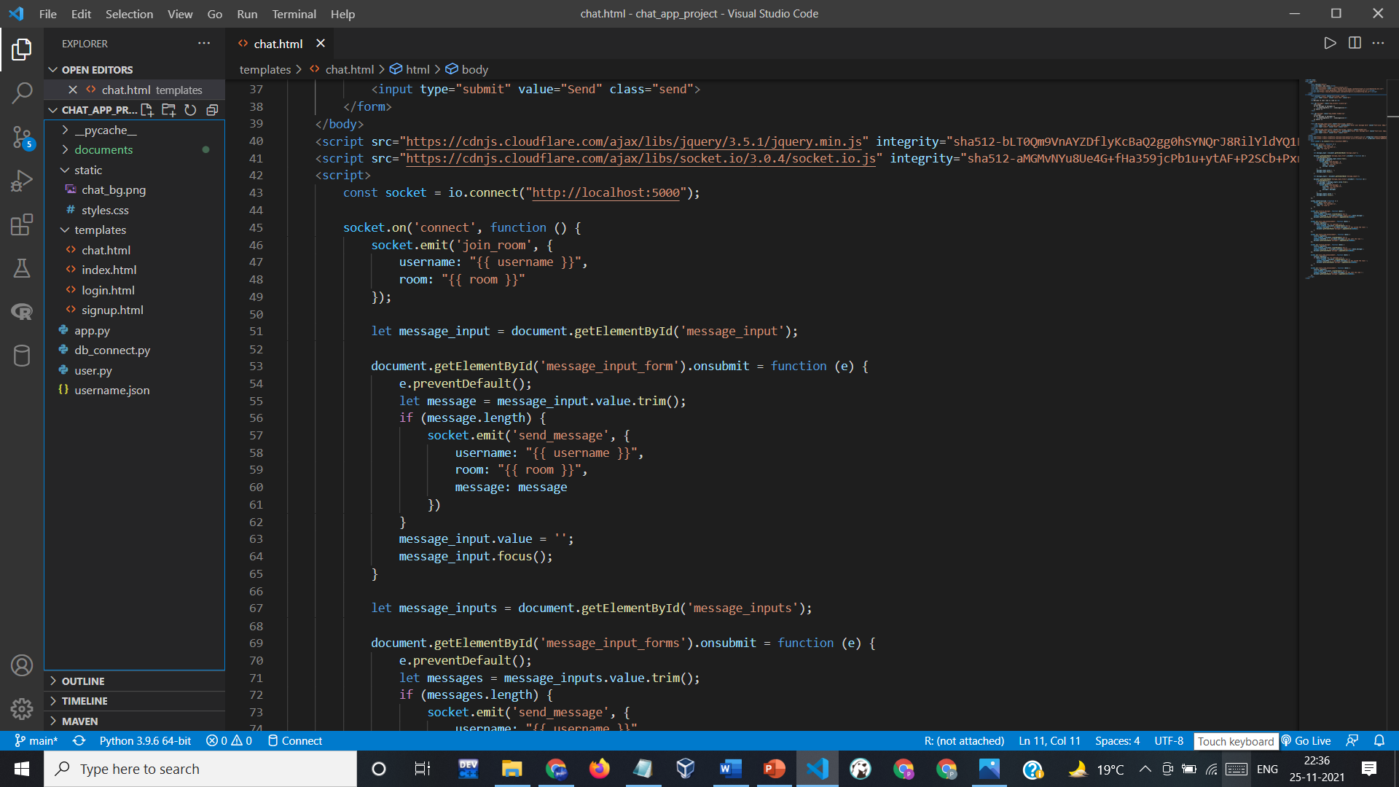
4. MESSAGING PAGE :

Slide 16
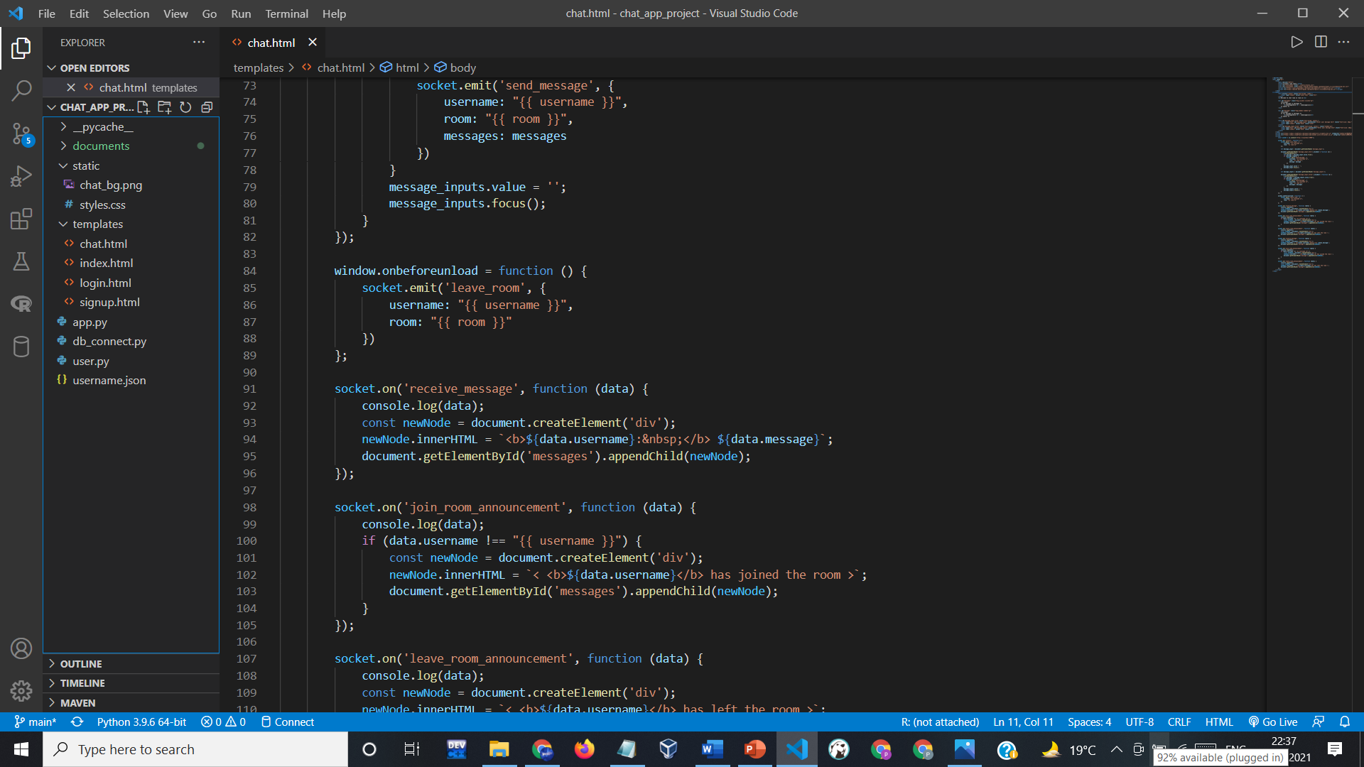
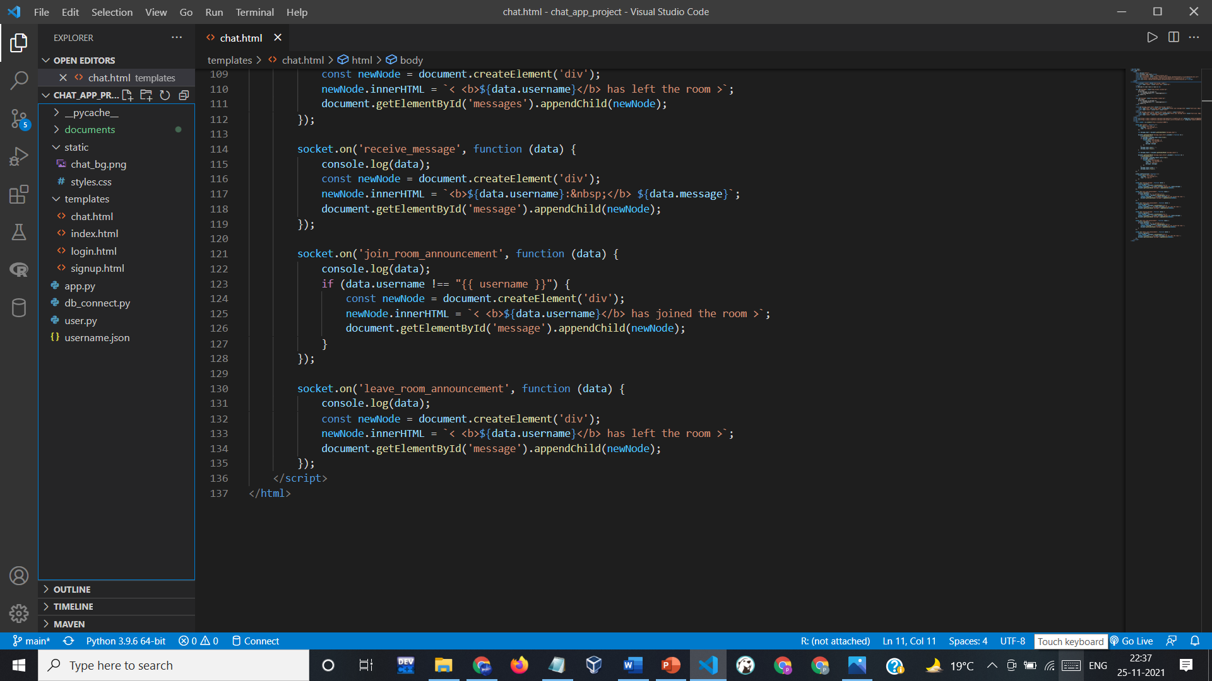
4. MESSAGING PAGE :

Slide 17
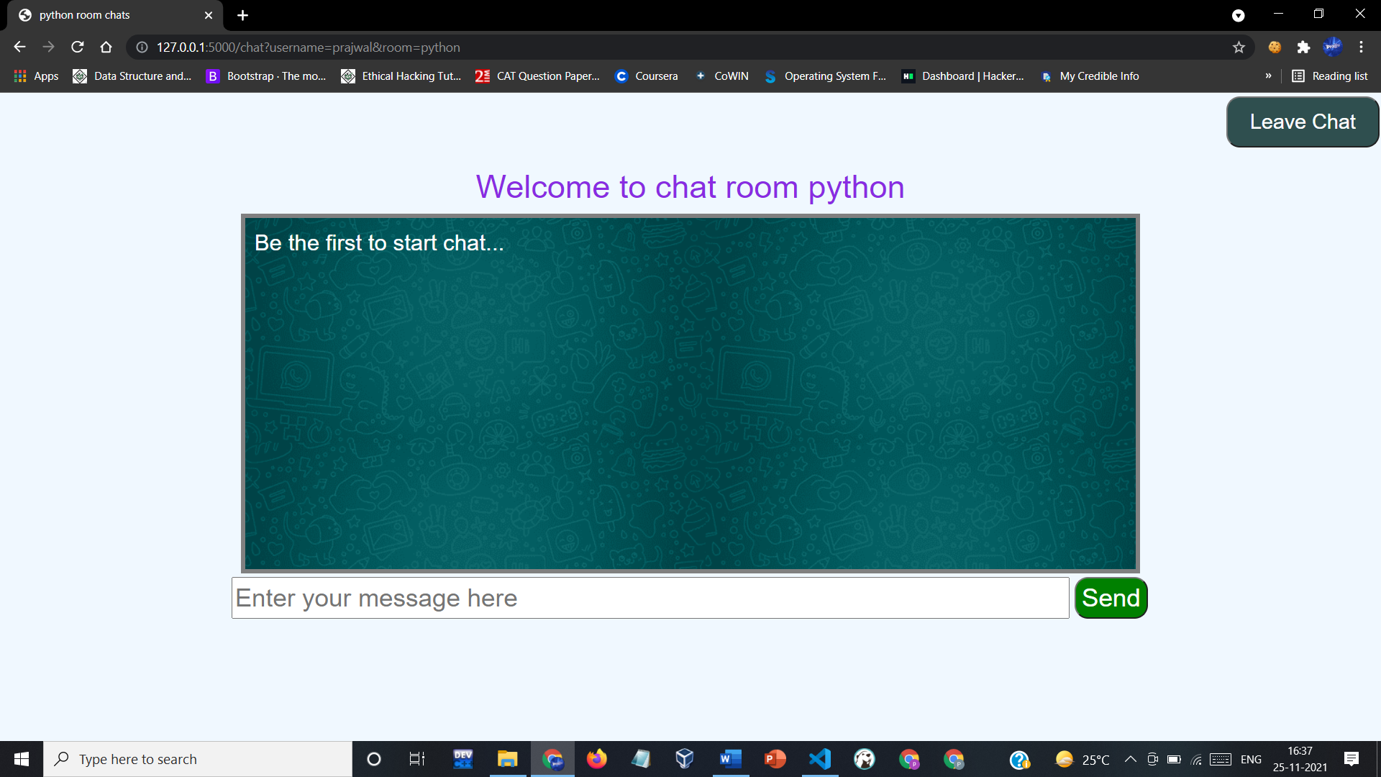
4. MESSAGING PAGE :

Slide 18
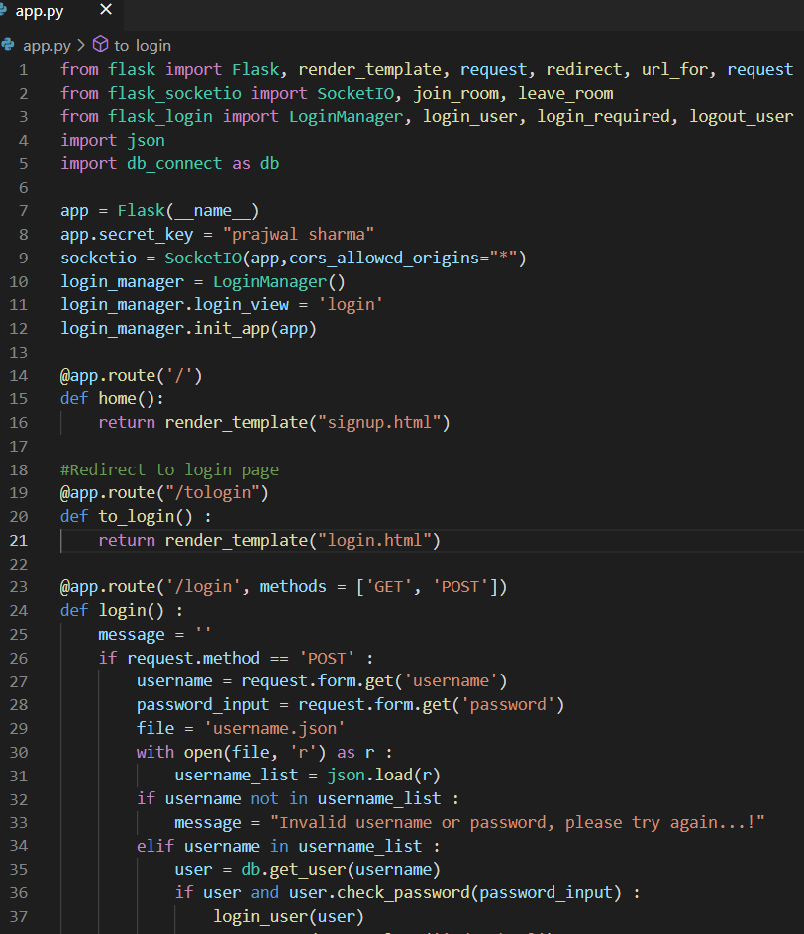
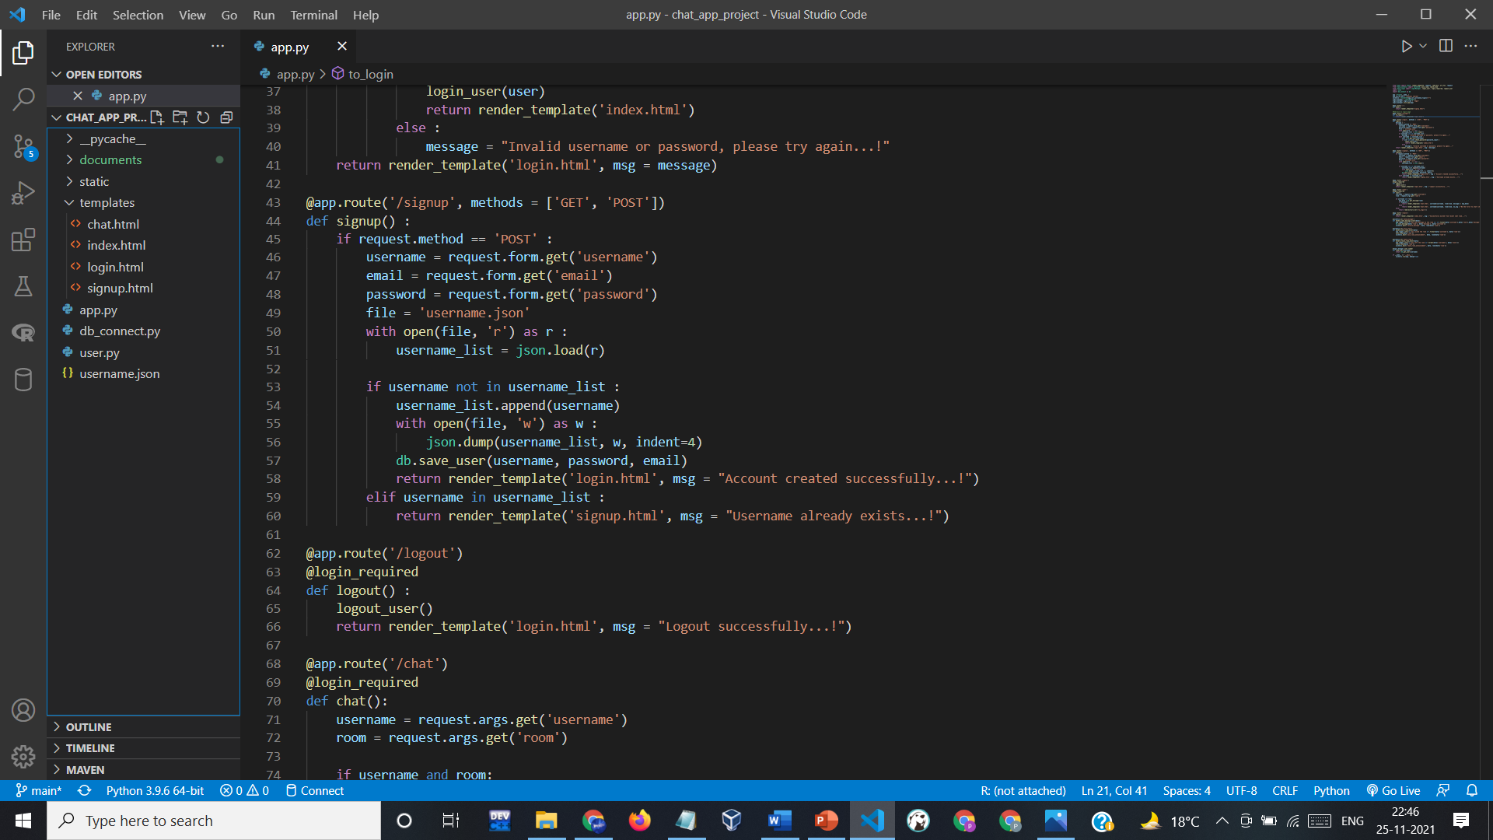
5. PYTHON CODE :

Slide 19
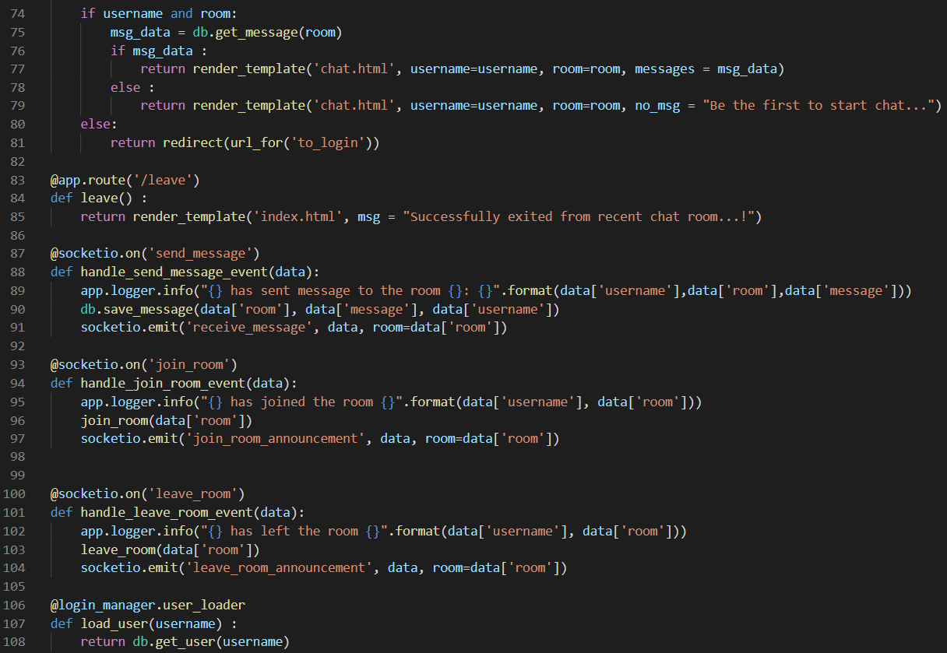
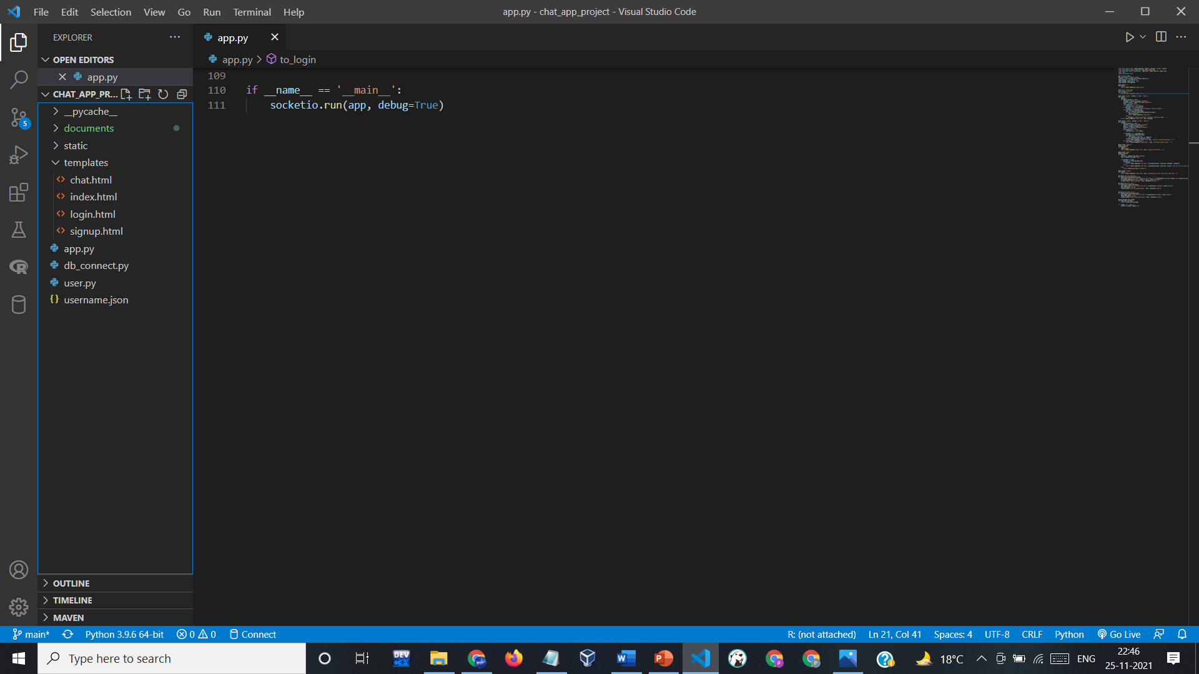
5. PYTHON CODE :

Slide 20
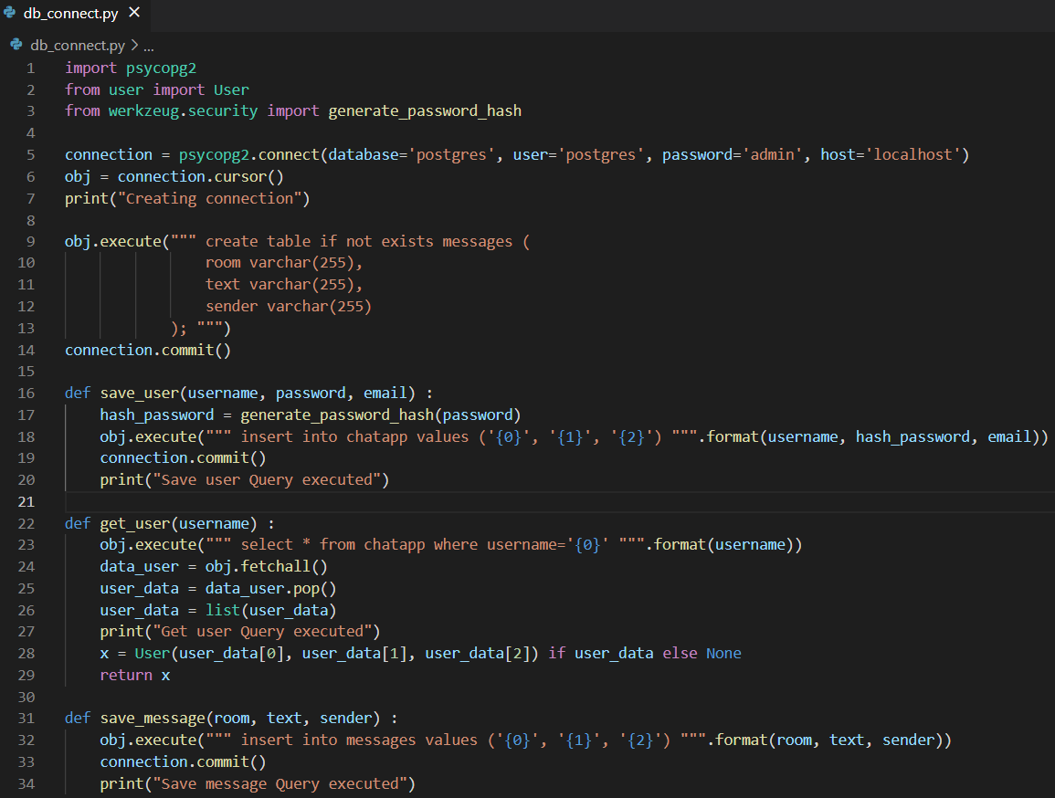
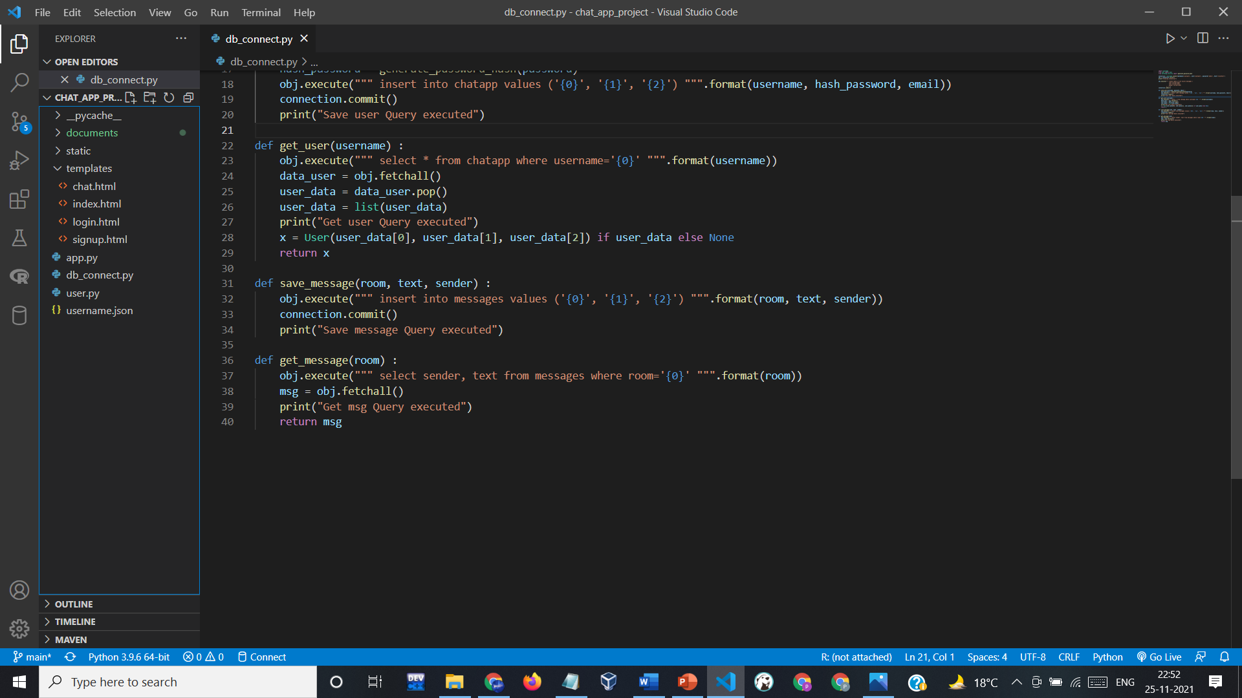
6. DATABASE PART :

Slide 21
WORKING
Here’s the implementation of our project. Below is the front end page that is displayed when we first open our application.
This application connects random people with each other and they can talk without actually showing their names.

Slide 22
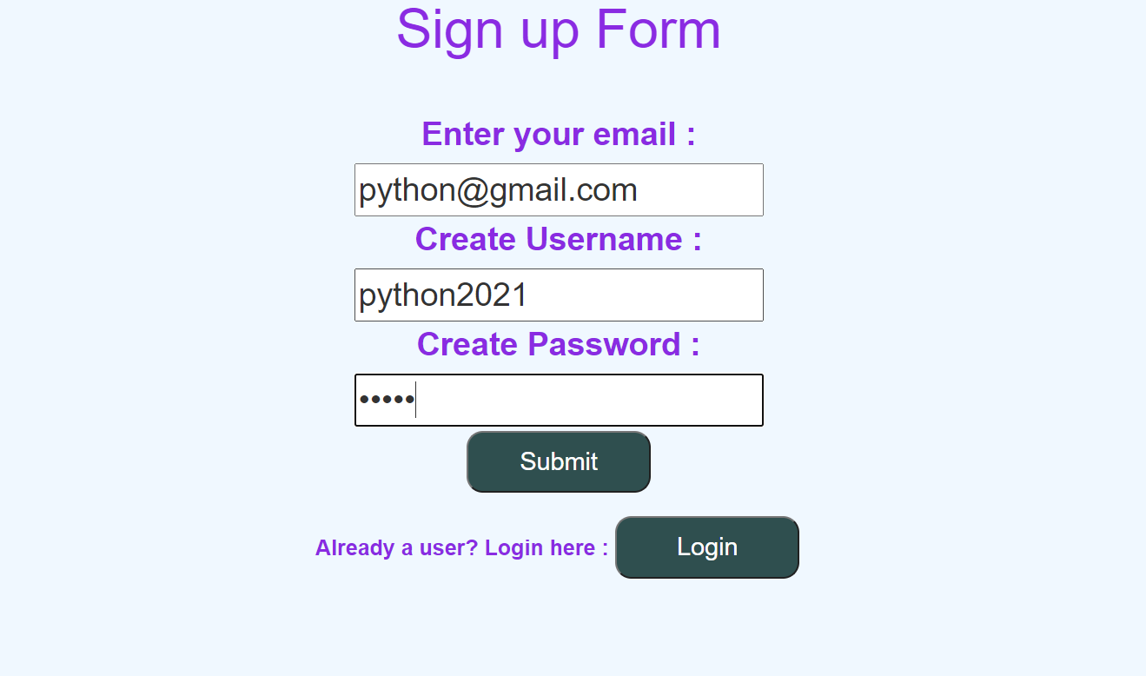
WORKING
1. Firstly, we have to register ourself by simply entering email id and creating username and password.
Here you can see that if we are already a user, we can simply go to login page from here also.

Slide 23
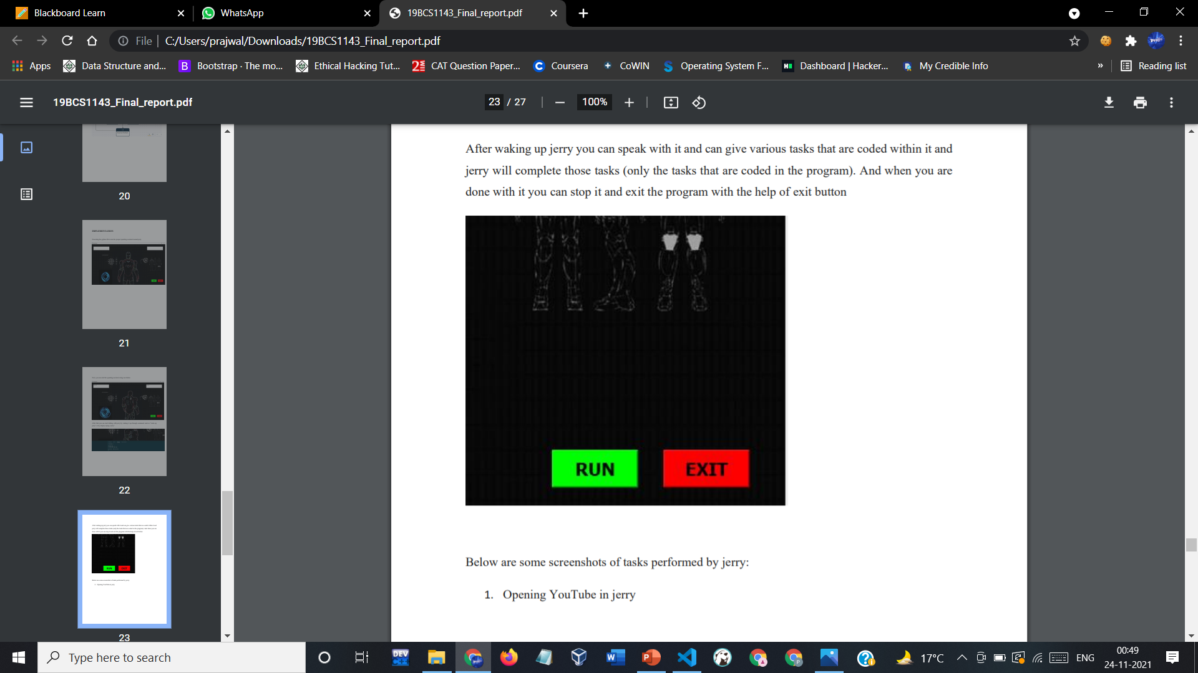
WORKING
After waking up jerry you can speak with it and can give various tasks that are coded within it and jerry will complete those tasks (only the tasks that are coded in the program). And when you are done with it you can stop it and exit the program with the help of exit button

Slide 24
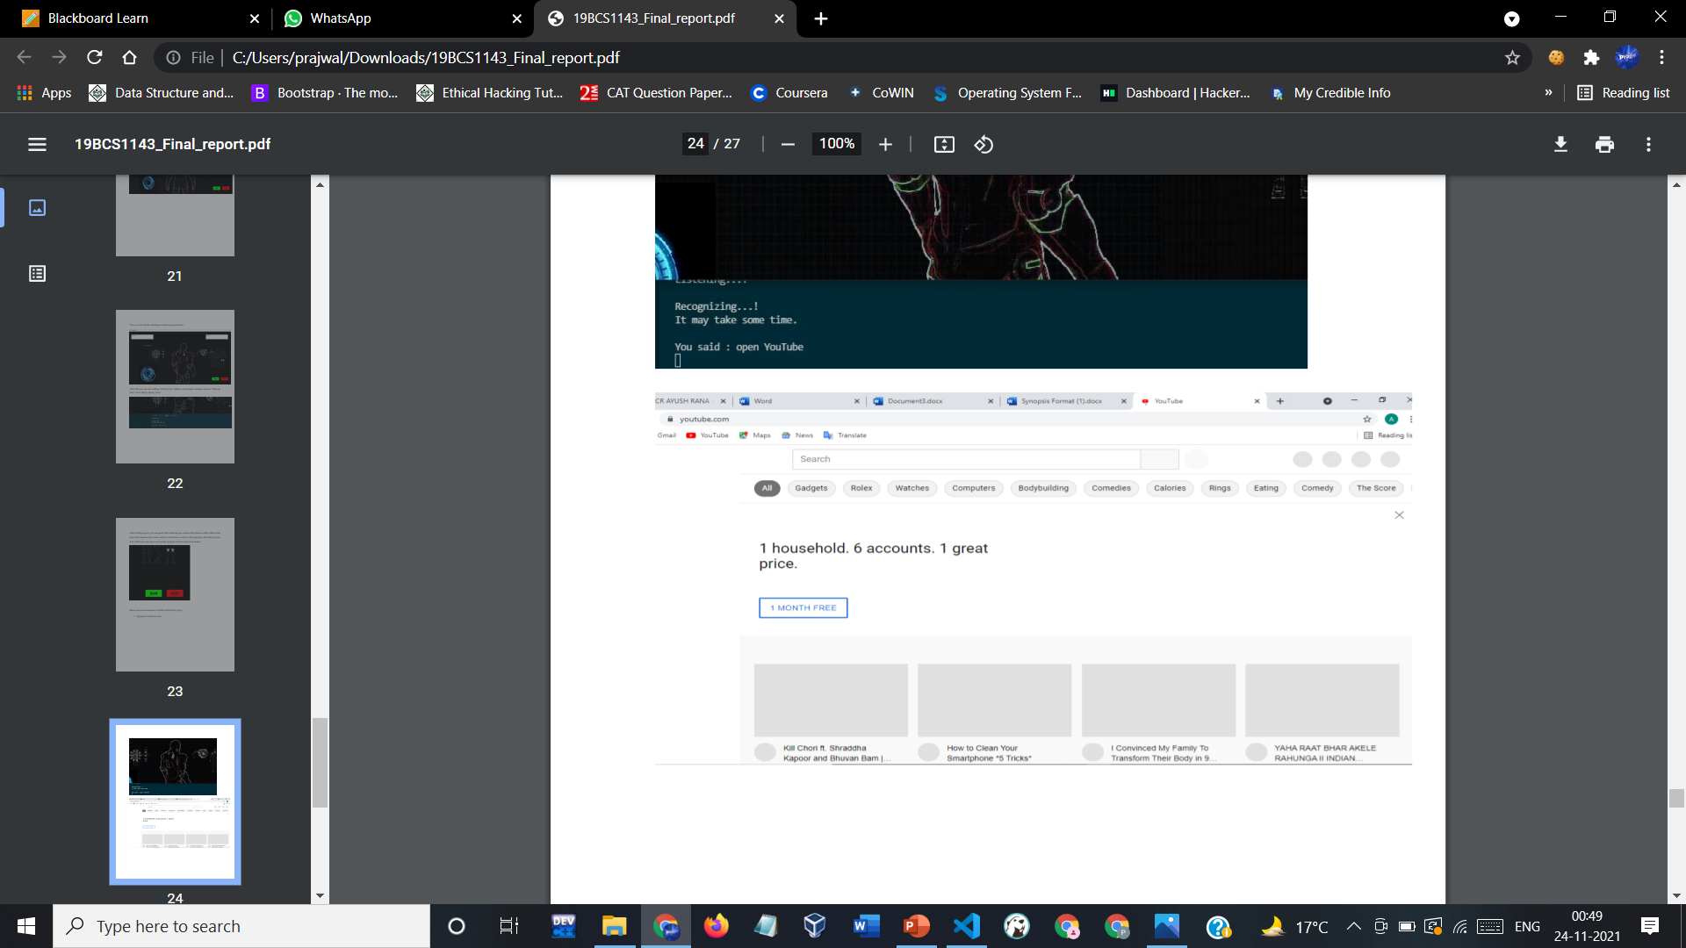
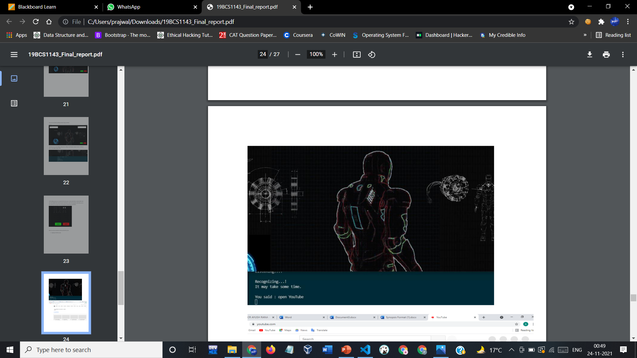
WORKING
Below are some screenshots of tasks performed by jerry :
1. Opening YouTube in jerry

Slide 25
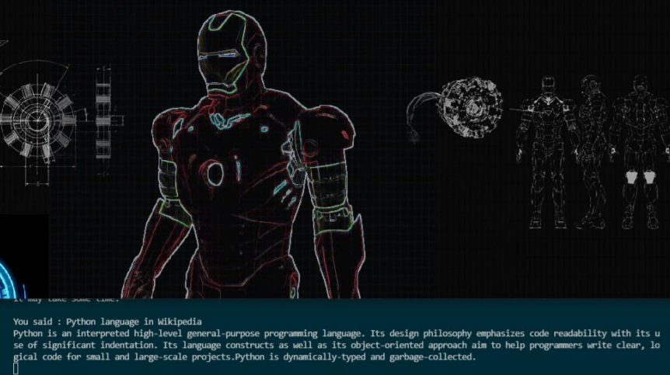
WORKING
2. Searching in Wikipedia

Slide 26
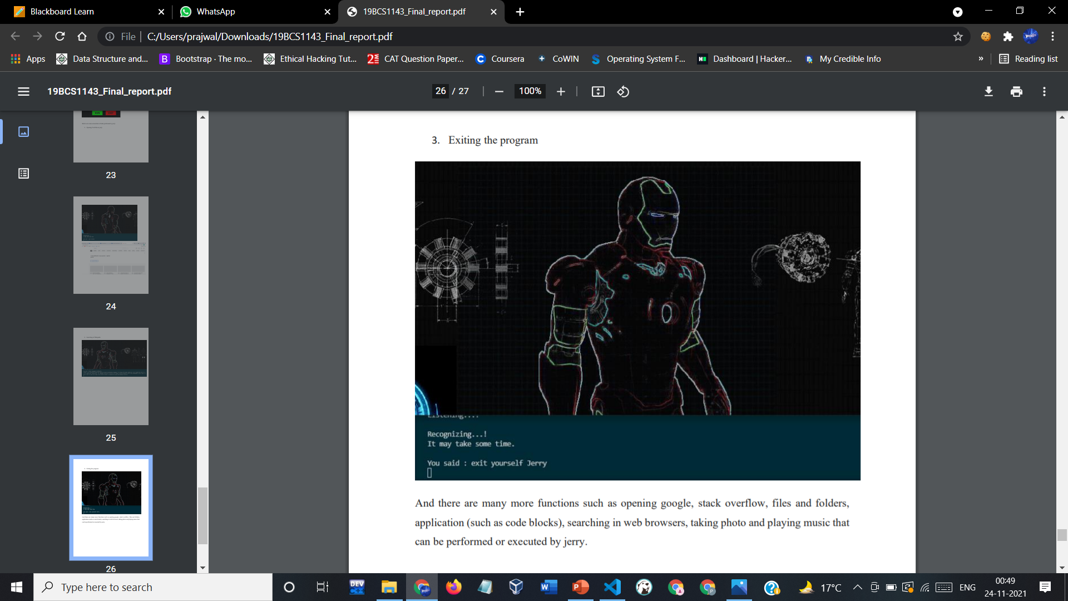
WORKING
3. Exiting the program
And there are many more functions such as opening google, stack overflow, files and folders,
application (such as code blocks), searching in web browsers, taking photo and playing music that can be performed or executed by jerry.

Slide 27
TEAM WORK
Throughout the project building and documentation process, we have worked as a team and have learned a lot from each other working in a team. We shared each other’s ideas and brainstormed on a lot of topics which finally led us to build this amazing software ourselves. Here, is what each one of us was majorly focusing on :
Modules & Team Member Wise Distribution Of Work :-
Module 1(GUI and Functioning):
User Interface
Speak Function
Listen function
Power Point Presentation
Module 2(Commands and Execution):
Teaching Jerry to perform all tasks.
Combining GUI and Functioning files to commands file and execute.
Diagrams
Report
Team members :
1. Ayush Rana (19BCS1143) – Module 2
2. Prajwal Sharma (19BCS1144) – Module 1

Slide 28

WHAT WE LEARNED
What all new technologies we learned:-
Python
PyQt GUI
More important things that we learned:-
Working in a team
Time Management
Working under deadlines
Setting and achieving goals in project building.
Managing and leading team to success.
Debugging our code
Utilize resources on the internet in the best possible manner.
Doing project documentation (Proposal, Synopsis, Progress reports etc.).
Presentation skills for presenting our ideas clearly.

Slide 29


